Slide 1
Breast Cancer Classification using Deep Learning
Reshma Jayaprakash
Scifor Technologies Trainee
ID: STB03011

Slide 2
Introduction
Breast cancer is a disease in which abnormal breast cells grow out of control and form tumors. If left unchecked, the tumors can spread throughout the body and become fatal.
Breast cancer cells begin inside the milk ducts and/or the milk-producing lobules of the breast. The earliest form is not life-threatening. Cancer cells can spread into nearby breast tissue. This creates tumors that cause lumps or thickening.
This project shows a demo of how a breast cancer can be classified based on the features that are computed from a digitized image of a fine needle aspirate (FNA) of a breast mass.

Slide 3
Objective
Our objective is to diagnose the possibility of Breast Cancer using Deep Learning method, based on the data collected from the Fine Needle Aspiration Test.

Slide 4
Project Workflow
1. Data Collection
6. Model Deployment
2. Exploratory Data Analysis
5. Model Evaluation
3. Data Visualization
4. Model Selection & Building

Slide 5
Data Collection
Data Source: https://goo.gl/U2Uwz2
This data consist of 30 Features and 569 Instances
Features are computed from a digitized image of a fine needle aspirate (FNA) of a breast mass
They describe characteristics of the cell nuclei present in the image
Exploratory Data Analysis
Data Preprocessing
Checked for missing values – No missing values found
Checked for outliers – Outliers are present, No outliers are removed based on the domain.
Data Visualization
Heatmap of data created to visualize the correlation between features
Boxplots are created to visualize the distribution and identify potential outliers
Visualization of plotly used to create a scatter matrix of some selected features

Slide 6
Ten real-valued selected features are computed for each cell nucleus:
a) Radius (mean of distances from center to points on the perimeter)
b) Texture (standard deviation of gray-scale values)
c) Perimeter
d) Area
e) Smoothness (local variation in radius lengths)
f) Compactness (perimeter^2 / area - 1.0)
g) Concavity (severity of concave portions of the contour)
h) Concave points (number of concave portions of the contour)
i) Symmetry
j) Fractal dimension ("coastline approximation" - 1)
Model Selection & Building
Built a simple Neural Network model using TensorFlow's Keras API
TensorFlow's Keras API is a high-level neural networks API that is part of the TensorFlow machine learning framework
Keras provides a user-friendly, modular, and efficient interface for building and training deep learning models

Slide 7
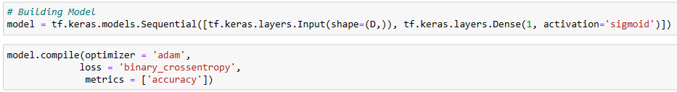
Neural network with one dense layer and a sigmoid activation function is defined
Sequential: This creates a linear stack of layers in the neural network model
Input: Defines the input layer with a shape of (D,), where D is the number of features
Dense: Adds a fully connected layer with one neuron (output) and a sigmoid activation function
This is a binary classification problem, and the sigmoid activation is suitable for binary classification tasks
Compile: Configures the model for training
optimizer='adam': Specifies the Adam optimization algorithm, a popular optimizer for gradient descent

Slide 8
loss='binary_crossentropy': Defines the loss function for binary classification problems
metrics=['accuracy']: Specifies the metric(s) to be evaluated during training. In this case, it monitors accuracy
Fit: Trains the model on the training data
X_train, y_train: Training data and labels
validation_data=(X_test, y_test): Validation data to monitor model performance during training
epochs=100: Number of times the entire dataset is passed through the neural network during training

Slide 9
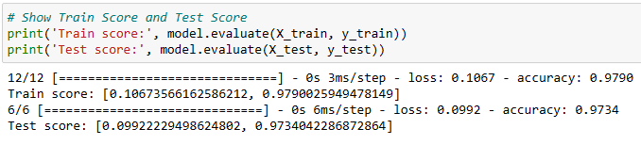
Model Evaluation
evaluate: Evaluates the model on the specified data.
X_train, y_train: Training data and labels used to print the training score.
X_test, y_test: Test data and labels used to print the test score.
Model Deployment
Streamlit is used for creating the web app, and other libraries are imported for data manipulation, deep learning, and visualization
Dashboard URL: https://reshma-jp-bcc-dl.streamlit.app/

Slide 10
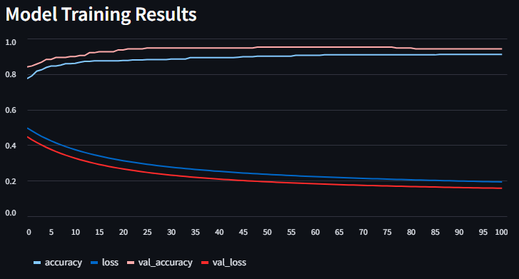
Results
Fig. 1 Accuracy and Loss over Epochs

Slide 11
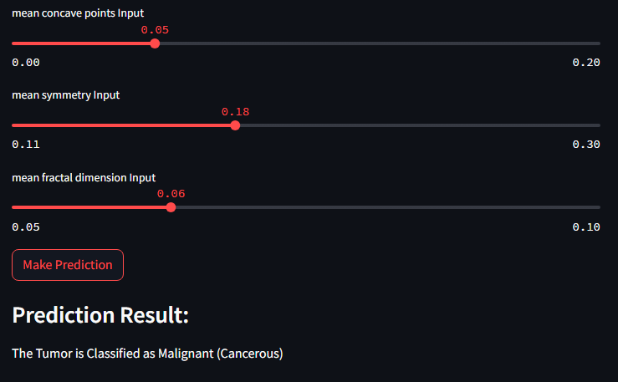
Fig. 2 Predictions Results of Diagnosis of Cancer

Slide 12
Thank you

